Slide 1
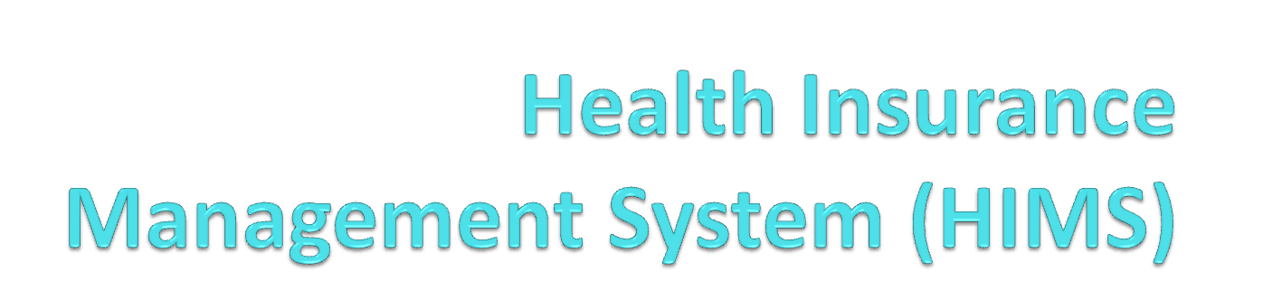
Chunlan Gao, Osama Akhtar
Dr. George
CIS Dept., Clark Atlanta University

Slide 2
Introduction
A Health Insurance Management System (HIMS) is used to seamlessly assimilate the insurance and hospital industries in the United States.
The goal is to provide better care at a cheaper cost.
The HIMS project we are focusing is highly customer-drive, or Business-to-Consumer (B2C).

Slide 3
Project Preparation
This project comes with a fully comprehensive Software Requirements Document (SRD) which is industry standard.
Furthermore, UML Diagrams were drawn and developed using the Unified Modeling Language (UML) in StarUML and Visio.

Slide 4
Project Description
This project comes with at least 7 requirements, 10 functions, a highly interactive user interface, graphical user interface in the Java programming language, and a web-based version using Java Server pages (JSP) and Tomcat.
A minimum of 5 requirements and 5 functions were asked.
Furthermore, this project comes with a database in two versions – MS Access and in JSP.

Slide 5
Project Diagrams
The below diagrams are shown in the two Java programs and the four JSP web pages.
They are also included in the CD.

Slide 6
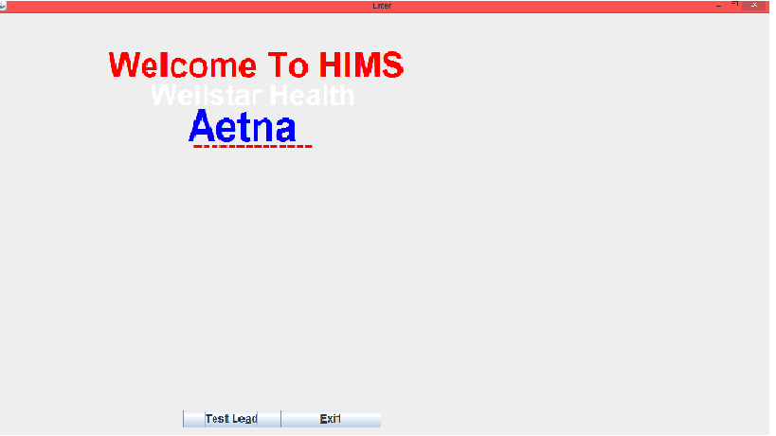
Java Programs: Page 1

Slide 7
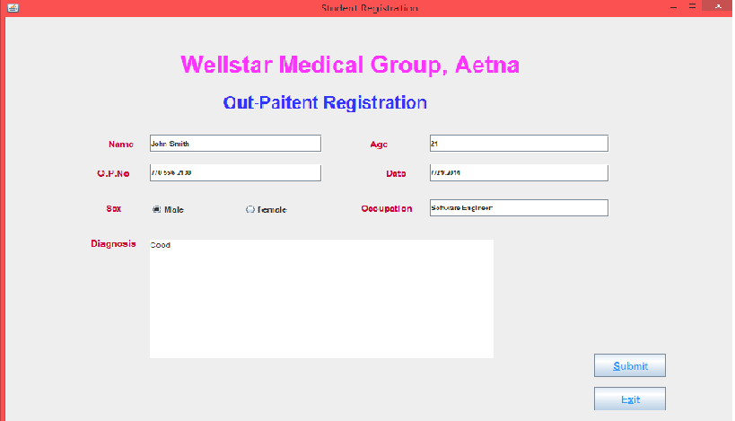
Java Programs: Page 2

Slide 8
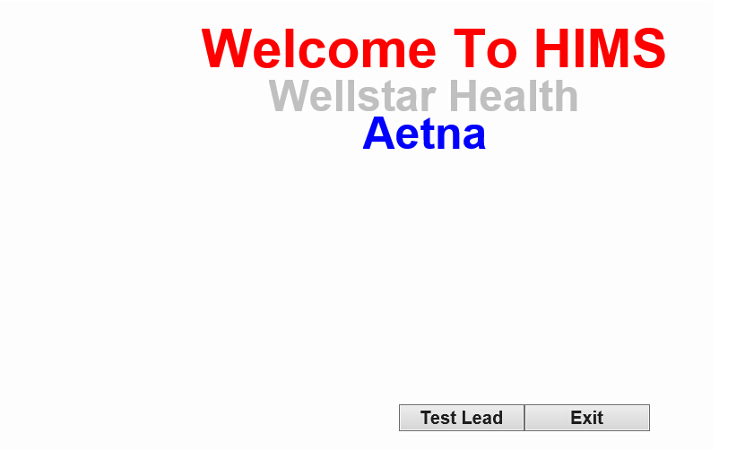
Project Diagrams: Page 1

Slide 9
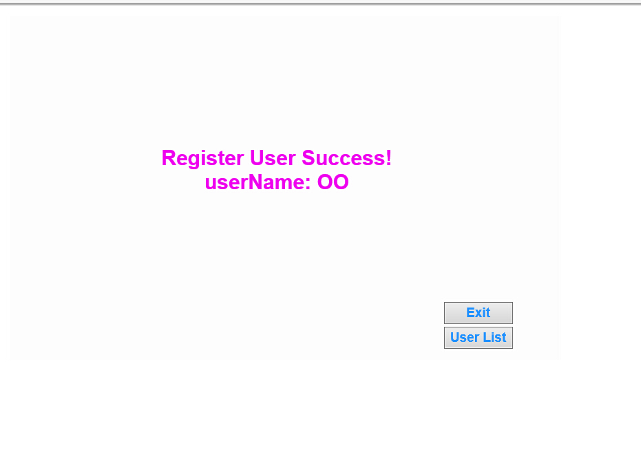
Project Diagrams: Page 2

Slide 10
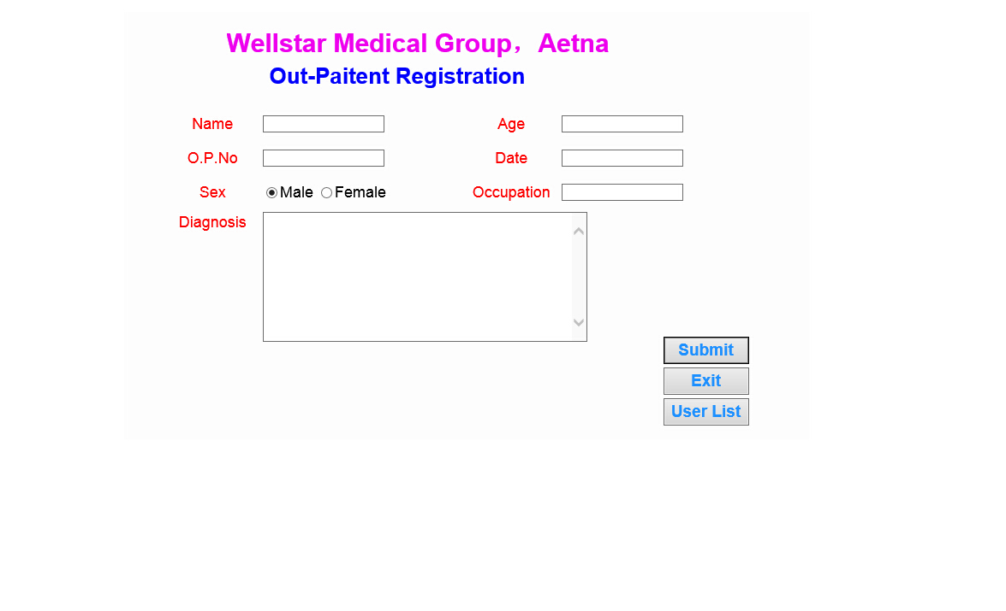
Project Diagrams: Page 3

Slide 11
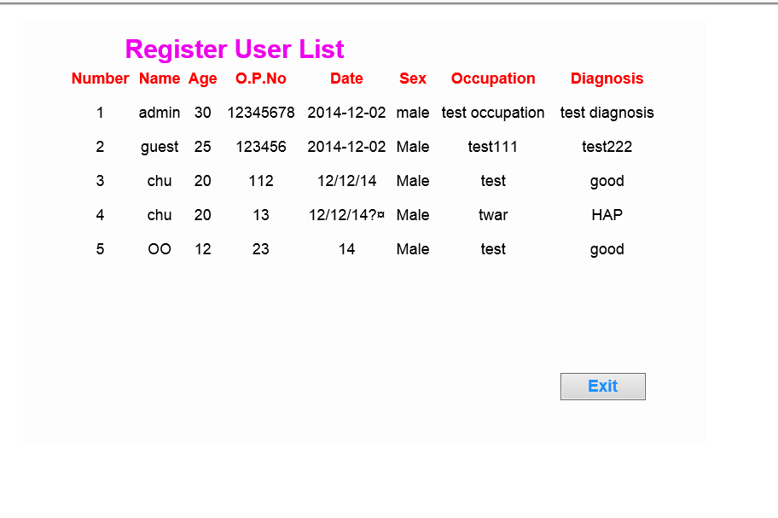
Project Diagrams: Page 4

Slide 12
Conclusion
This project was highly interactive and is consumer focused.
Particular attention was paid to B2C.
We hope users will find the program to be highly interactive, fun, and engaging.

Slide 13
References
www.tomcat.apache.org

